Slide 1

CHAPTER 1
Analyzing
Economic
Problems

Slide 2

Chapter One Overview
Defining Microeconomics
Who Should Study Microeconomics?
Microeconomic Modeling
Elements of Models
Solving the Models
The Types of Microeconomic Analysis
Chapter One

Slide 3
Microeconomics Defined
Microeconomics is the study of how individual economic decision-makers such as consumers, workers, firms or managers allocate scarce resources among alternate uses.
This study involves both the behavior of these economic agents on their own and the way their behavior interacts to form larger units, such as markets.
Chapter One

Slide 4
Who Should Study Microeconomics?
Policy Makers
Managers
Union Leaders
Lenders
Business Owners
Chapter One

Slide 5
Key Societal Questions
Societies must answer these questions that relate to microeconomics:
What goods and services will be produced and in what quantities
Who will produces these services and how will they produce them
Who will receive these goods and services and how will they get them
Chapter One

Slide 6
Microeconomic Modeling
Choice vs. Alternatives
Models are like maps – using visual methods, they simply the process and facilitate understanding of complex concepts. Microeconomic models need to:
Resemble Reality
Be Understandable
Be an Appropriate Scale
Chapter One

Slide 7
Exogenous & Endogenous Variables
Defined:
Variables that have values taken as given in the analysis are exogenous variables. Variables that have values determined as a result of the model’s workings are endogenous variables.
“How would a manager hire the most possible workers on a budget of $100?”
vs.
“How would a manager minimize the cost of hiring three workers?”
OR
“How much food and clothing should the consumer purchase in order to maximize satisfaction on a budget of I?”
vs.
“What is the minimum level of expenditure that the consumer must receive in order to reach a subsistence level of satisfaction?”
Examples:
Chapter One

Slide 8
The Objective Function
Dependent on How the Objective Function is Specified
Defined:
The Objective Function specifies what the agent cares about.
Example:
Does manager care more about raising profits or increasing “power”?
Chapter One

Slide 9
The Constraints
Defined:
Constraints are whatever limits is placed on the resources available to the agent.
Examples:
Time
Budget
Other Resources
Technical Capabilities
The Marketplace
Rules, Regulations, and Laws
Chapter One

Slide 10
The Constraint Optimization
Behavior can be modeled as optimizing the objective function, subject to various constraints.
Example:
Manager’s Investment Choice
Facilities ( F ): N = budget / $30
R&D ( R ): N = budget / $100
Max N
(F,R)
Subject to: expenditure < $100
Where: N is the number of workers
Cost Per Unit of Time
Facilities workers cost $30
R&D workers cost $100
Chapter One

Slide 11
The Constraint Optimization
Example:
Consumer purchases
Food (F), Clothing ( C ), Income (I)
Price of food (pf), price of clothing (pc)
Satisfaction from purchases: S = (FC)^{1/2}
Max S(F,C) - subject to: p_{f} F + p_{c} C < I
Chapter One

Slide 12
The Constraint Optimization
Example – Consumer Purchases
F
Example:
P_{F}F + P_{C}C = I
C
0
Chapter One

Slide 13
The Constraint Optimization
Example – Consumer Purchases
F
Example:
P_{F}F + P_{C}C = I
(FC)^{1/2} = S₀
C
0
Chapter One

Slide 14
The Constraint Optimization
Example – Consumer Purchases
F
Example:
P_{F}F + P_{C}C = I
(FC)^{1/2} = S₁
(FC)^{1/2} = S₀
C
0
Chapter One

Slide 15
The Constraint Optimization
Example – Consumer Purchases
F
Example:
P_{F}F + P_{C}C = I
S₂ > S₁ > S₀
(FC)^{1/2} = S₂
(FC)^{1/2} = S₁
(FC)^{1/2} = S₀
C
0
Chapter One

Slide 16
Marginal Impact
Defined:
The Marginal Impact of a change in the exogenous variable is the incremental impact of the last unit of the exogenous variable on the endogenous variable.
Chapter One

Slide 17
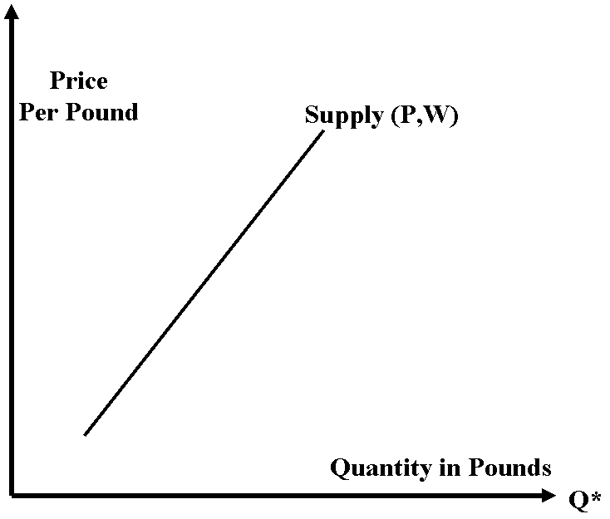
Equilibrium
Example – Sale of Coffee Beans
Chapter One

Slide 18
Equilibrium
Example – Sale of Coffee Beans
•
Demand (P,I)
Chapter One

Slide 19
Equilibrium
Example – Sale of Coffee Beans
•
P*
Demand (P,I)
Q*
Chapter One

Slide 20
Equilibrium
Defined:
Equilibrium is defined as the point where demand just equals supply in this market (i.e., the point where the demand and supply curves cross).
Equilibrium analysis is an analysis of a system in a state that will continue indefinitely as long as the exogenous factors remain unchanged.
Chapter One

Slide 21
Comparative Statics Analysis
Defined:
A Comparative Statics Analysis compares the equilibrium state of a system before a change in the exogenous variables to the equilibrium state after the change.
Chapter One

Slide 22
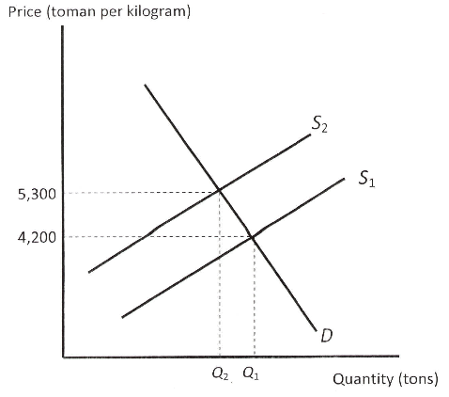
Comparative Statics Analysis
Sale of
Pistachio Nuts
Chapter One

Slide 23
Microeconomic Analysis
Some Types
Positive Analysis:
Is an analysis that attempts to explain how an economic system works or to predict how it will change over time
Normative Analysis:
Is an analysis of what should be done
Chapter One

Slide 24
Microeconomic Analysis
Some Examples
Example: “Should we increase income equality rather than focus on economic efficiency?”
Example: “Should we impose a progressive income tax or a sales tax to increase income equality?”
Example: “Will a progressive income tax reduce aggregate hours worked?”
Chapter One

